Slide 1
INTRODUCTION
Interest in modeling traffic flow has been around since the appearance of traffic jams. Ideally, if we can correctly predict the behavior of vehicle flow given an initial set of data, then, in theory, adjusting the flow in crucial areas can maximize the overall throughput of traffic along a stretch of road. This is of particular interest in regions of high traffic density, which may be caused by high-volume peak time traffic, accidents or closure of one or more bones of the road.
The analysis of network flow analysis through a definite road channel during peak traffic hour shows how the system of linear equation can be used in practical life.

Slide 2
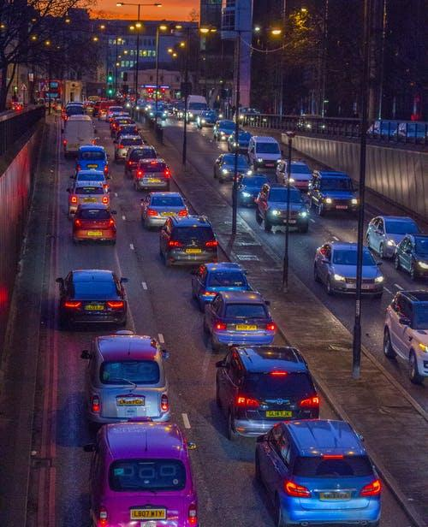
Project overview
Project domain: Traffic flow
Project title: Solve real life traffic problems using system of linear equations

Slide 3
Background
Analysis of traffic flow of network of streets using a system of linear equations.
A graph is constructed from the data obtained of vehicles passing through the streets.
Certain assumptions are made in order to conduct the process smoothly.
A system of equations is obtained from the graph which is further solved using techniques of linear algebra.

Slide 4
Motivation
Traffic jams have many severe consequences on human health and economy.
The delay in time for reaching any destination has also increased significantly due to which many problems are caused.
The amount of CO2 and other harmful gases that are emitted is significantly high which are not good signs for the future.
Hence, the present study aims to reduce this problem by predicting the number of vehicles that can pass through the streets.

Slide 5
Problem Statement
Identifying real-life traffic problem in Andheri East, Mumbai for one way consisting 6 intermediate junctions and solving them using system of linear equations

Slide 6
Literature Survey
To control traffic jams, the number of vehicles permitted on a track at a particular time is important to be determined.
The idea for solving the problem of traffic flow was gained from one of the real-life problems in Kumasi, Ghana. They used a System of Linear Equations to Traffic Flow for a Network of Four One-Way Streets in Kumasi.
They used a system of linear equations to determine the number of vehicles to continue the traffic that should be allowed to pass through the four one-way streets in Kumasi.

Slide 7
Literature Survey
They used the Gauss-Jordan elimination method to solve systems of equations in the model.
Following assumptions were made while solving the problem to ensure the smooth flow of the traffic:-
i) Vehicles entering each intersection should always have the same number of vehicles leaving the intersection.
ii) Streets should be all one-way with arrows indicating the direction of traffic flow.

Slide 8
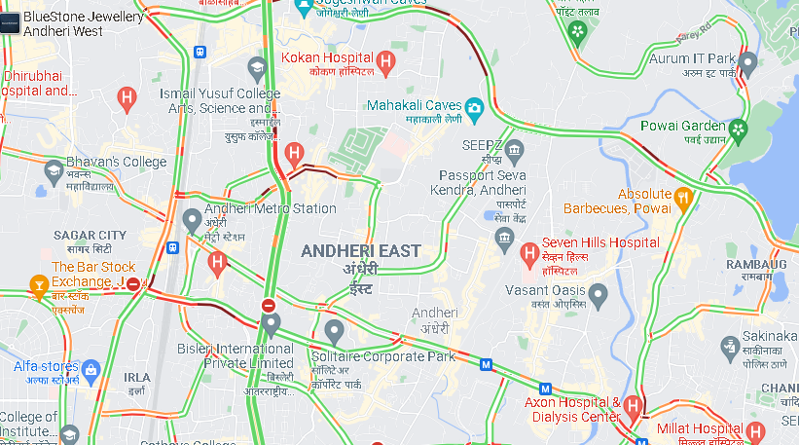
Reproduced Work

Slide 9
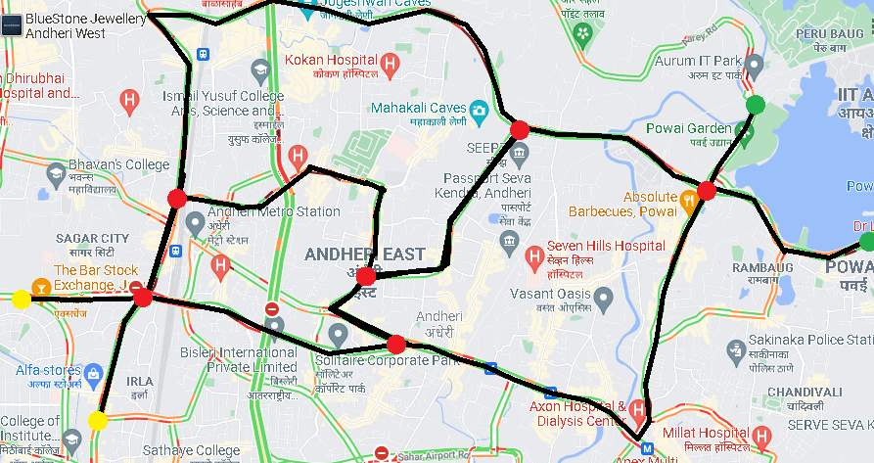
Traffic flow of Andheri East, Mumbai

Slide 10
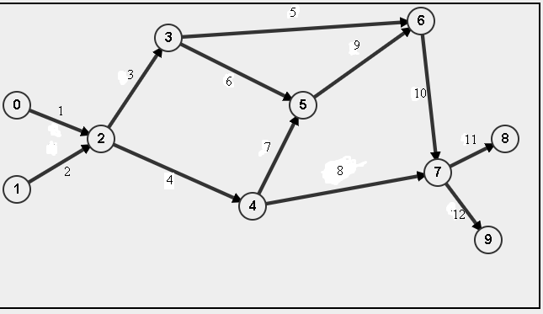
Graph of traffic flow

Slide 11
Graphical Information
Paths
Nodes
1. CD barfiwala road
2. Swami Vivekananda road
3. Swami Vivekananda road
4. Professor NS Phadke road
5. Jogeshwari – Vikhroli Link road
6. Mahakali caves road
7. Andheri road
8. Saki vihar road
9. MIDC central road
10. Jogeshwari – Vikhroli Link road
11. Saki vihar road
12. The view road
Mahindra NBS International
DCB Bank
Honda Big Wing Mumbai - Sales
MIDC
Speez village
Sakinaka Traffic Division

Slide 12
Rules to be applied
Node 0 and 1 are called source nodes. All the vehicles are enter from there.
Node 8 and 9 are called sink nodes. All the vehicles will exit from there.
All the other nodes are called intermediate nodes. At any given time number of vehicles entered and exited are remain unchanged at any intermediate node

Slide 13
CONTRIBUTIONS TO THE PROJECT
Raj Patel-He looked up the concept and ideas on the web and took part in team conversations to come up with an effective solution.
- Reproduced work on our network flow analysis was done by him and Soham.
Manthan Patel- He looked at a lot of web pages and articles for ideas on how to solve the answers perfectly.
-He was the mainframe for the plan of action of our project.
Vandan Shah- Designed the ppt for the final submission along with technical focus and team morale.
- He contributed the part of background, motivation.
Daksh Suthar-Along with his speed of execution single-handedly did the work of literature survey and references of the articles as well as helped a big-time during team chats.
Soham Jagrit- He contributed thoughts and suggestions to the project. Spend a significant amount of time advising other members on particular tasks involving their knowledge in their field.

Slide 14
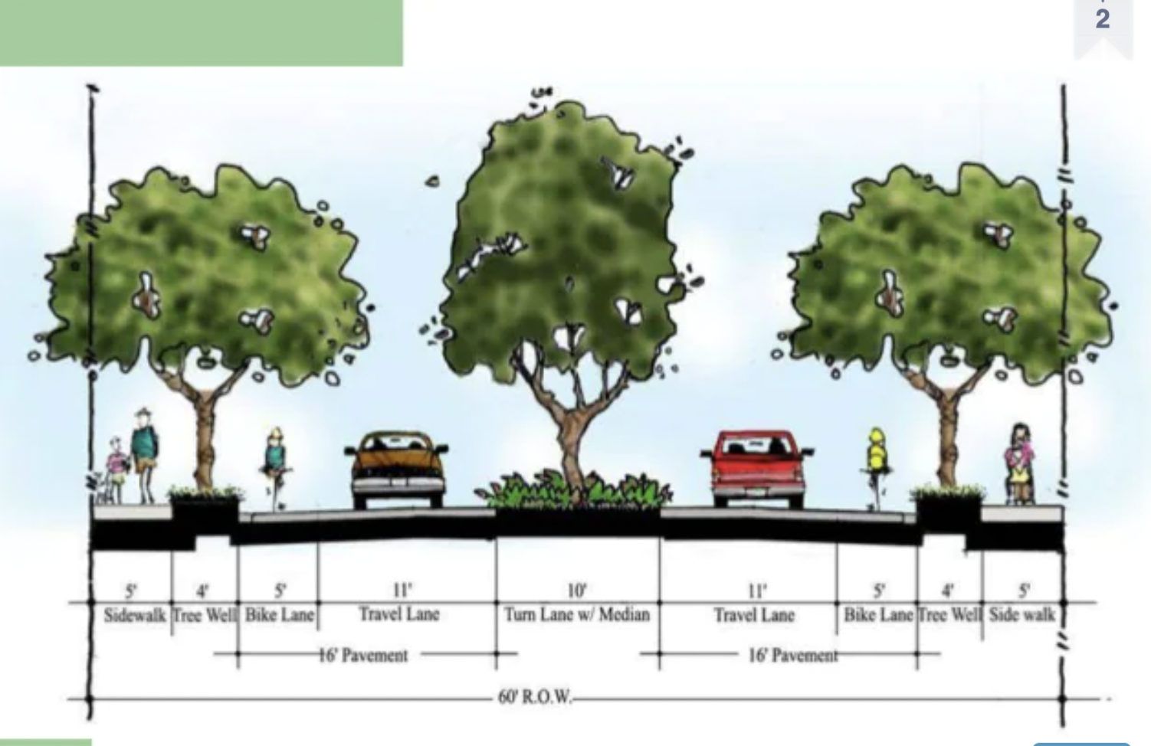

Slide 15
Note
If data are collected for traffic traveling in more than one lane and time headways are measured between consecutive vehicles passing between a point regardless of the lane they are in,
then very small headways are possible as the headway is computed between two vehicles that are not physically acting as a lead and following vehicle.
The traffic engineer must deal with elderly drivers as well as 18-year-olds,aggressive drivers and timid drivers, and drivers subject to distractions both inside and outside to their vehicles.

Slide 16
Plan of action
Based on the network analysis and the solution of systems of linear equations, we examine traffic flow theories. The model can have a single unique solution, infinitely numerous solutions, or no solution, as demonstrated by examples. This appears to be paradoxical. The bigger the capacity of a road, the more lanes it has, therefore vehicles should be able to travel quicker... yet that's an extremely narrow analysis of the situation or problem. The analysis of network flow analysis through a definite road channel during rush hour shows how the system of linear equation can be used in practical life. This also tries to figure out how many cars should indeed be permitted to pass via the one-way roadways analyzed in the situation in order to minimize traffic jams issues.

Slide 17

Plan of action
Our plan is to find traffic rates at particular path given vehicle rates at source and sink nodes.
In real life, there are situations where due to some function, rally, or marriage one road is blocked. In this situation, what will the effect of traffic on other roads? We will try to answer this question.

Slide 18
Group Details
Team 13 Algebros
1. Vandan Shah:- AU2040196
2. Manthan Patel:- AU2040123
3. Daksh Suthar:- AU2040167
4. Raj Patel:- AU2040115
5. Soham Jagrit:- AU2040060

